Slide 1
Project 1: Calculating Detection Signal of Different Methods for a Jupiter-like Planet around a Sun-like Star.
M. Berger, A. Bernhardt, M. Bleich, Y. Shi, A. Tarrant

Slide 2
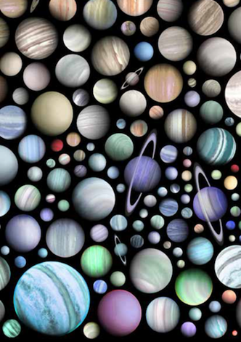
Motivation
Are we alone? – the search for life beyond Earth
What else is out there? – the exoplanet sky
Understand the different detection methods and their constrains
Calculating detection signal of different methods for a Jupiter-like planet
Is it possible to find a Jupiter-like planet around a Sun-like star with current our methods?

Slide 3
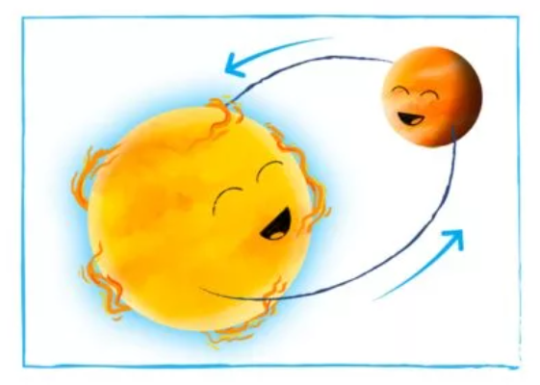
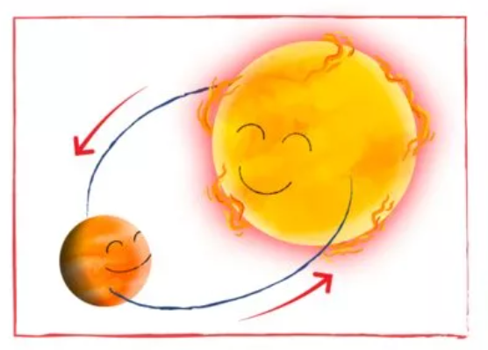
Methods - Radial Velocity
This method records light emitted from stars → We can’t see the exoplanet, but we can see the star move
Limitations:
Hard to find exoplanets in distant orbits
Cannot measure exoplanet diameter
Not great for finding small exoplanets

Slide 4
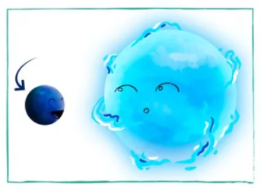
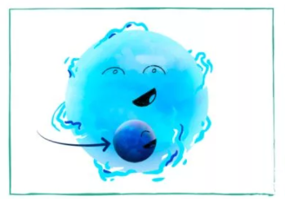
Methods - Transit Photometry
Analyzes when part of the light from a star is blocked by another planet
Limitations:
This method requires an exoplanet crossing a star
Hard to determine whether the blocking planet is actually a star
Cannot measure exoplanet mass

Slide 5
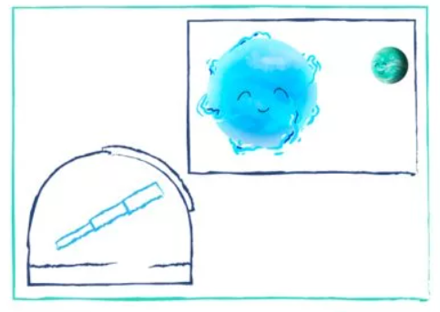
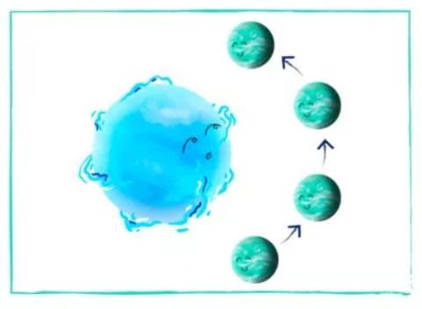
Methods - Direct Imaging
Taking snapshot in time of an exoplanet → actually seeing an exoplanet
When planets orbit close to their star, it overpowers the planet’s signal
Limitations:
Hard to find exoplanets that orbit bright stars
Cannot find many exoplanets at once
Not great for finding faraway exoplanets

Slide 6
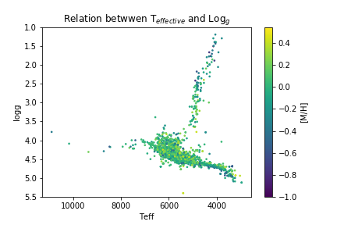
Relationship between T_{effective} and Log_{g}
Log_{g}

Slide 7
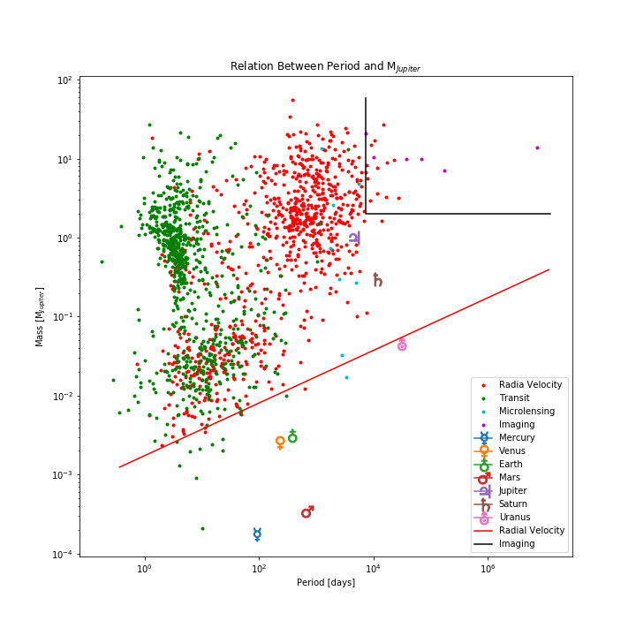
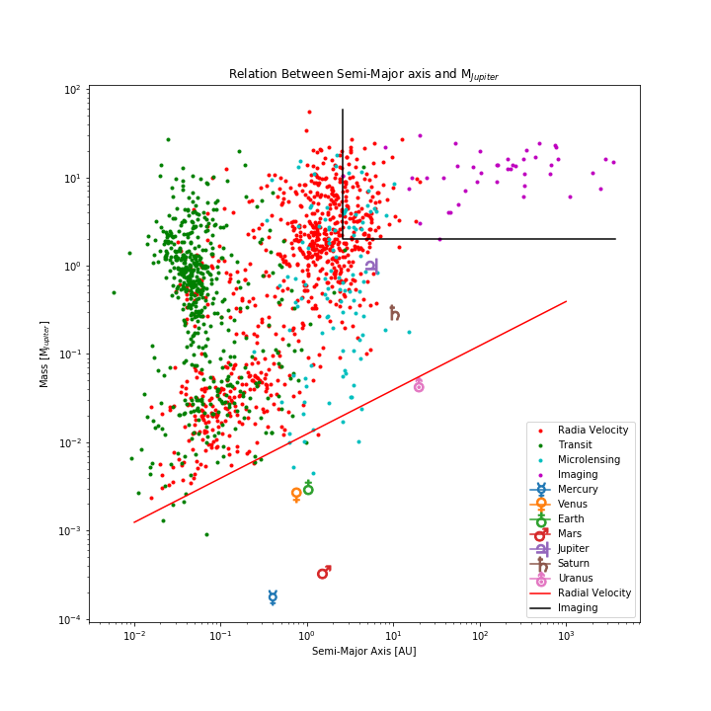

Slide 8
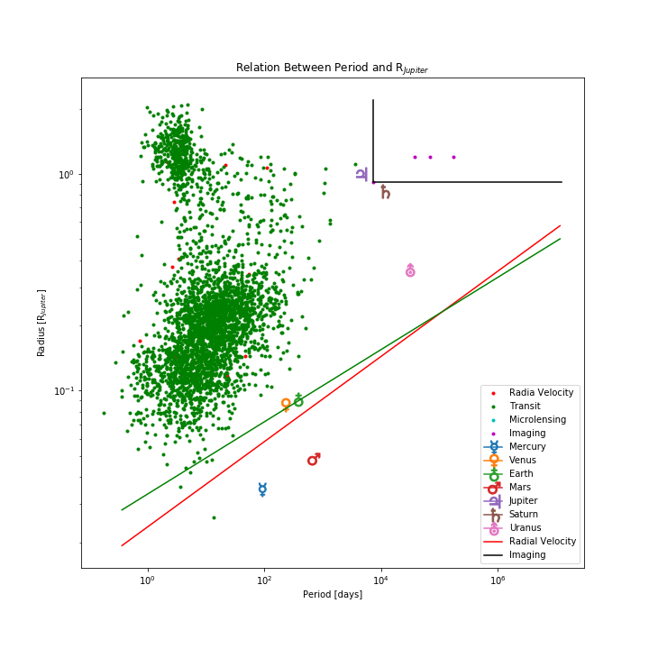
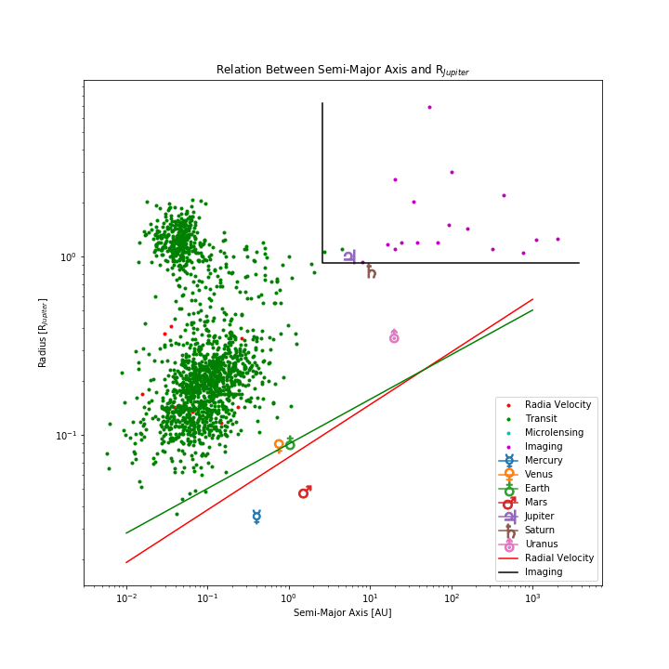

Slide 9
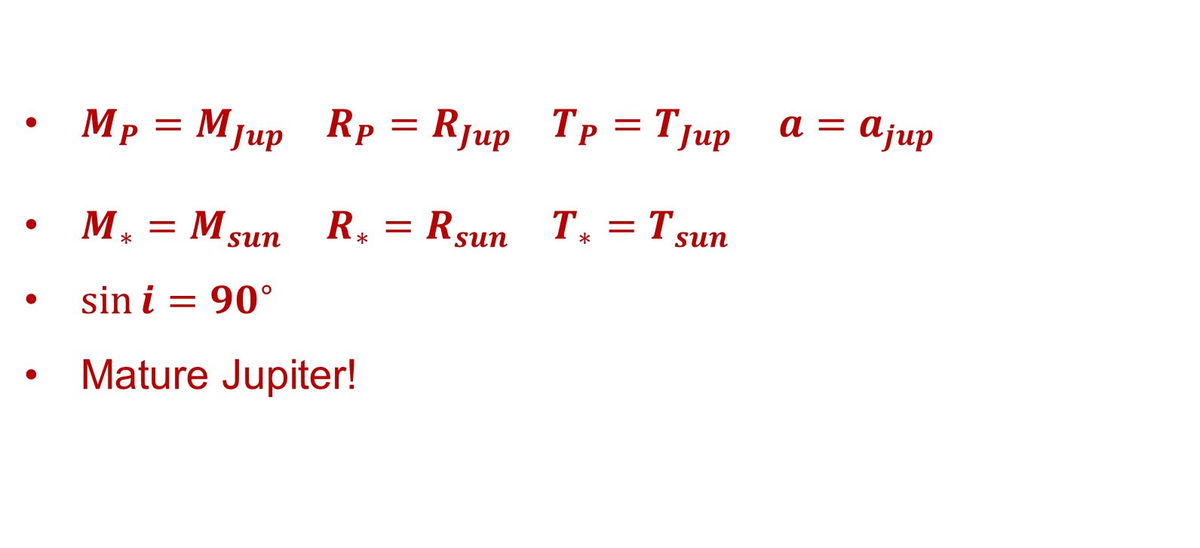
Assumptions – Jupiter-Like Planet Around a Sun-Like Star
$M_{P}=M_{Jup}$ $R_{P}=R_{Jup}$ $T_{P}=T_{Jup}$ $a=a_{jup}$
$M_{∗}=M_{sun}$ $R_{∗}=R_{sun}$ $T_{∗}=T_{sun}$
$\sin{i}={90}^{∘}$
Mature Jupiter!

Slide 10
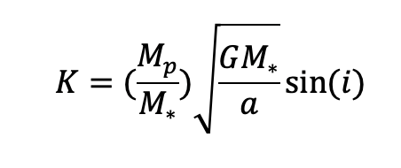
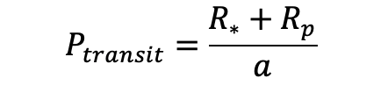
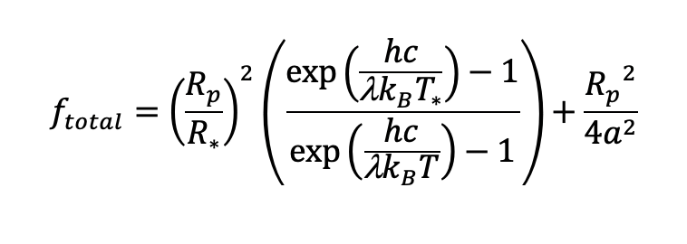
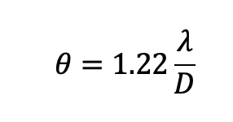
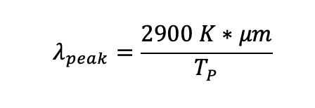
Equations
Radial Velocity:
Transit Photometry:
Direct imaging:

Slide 11
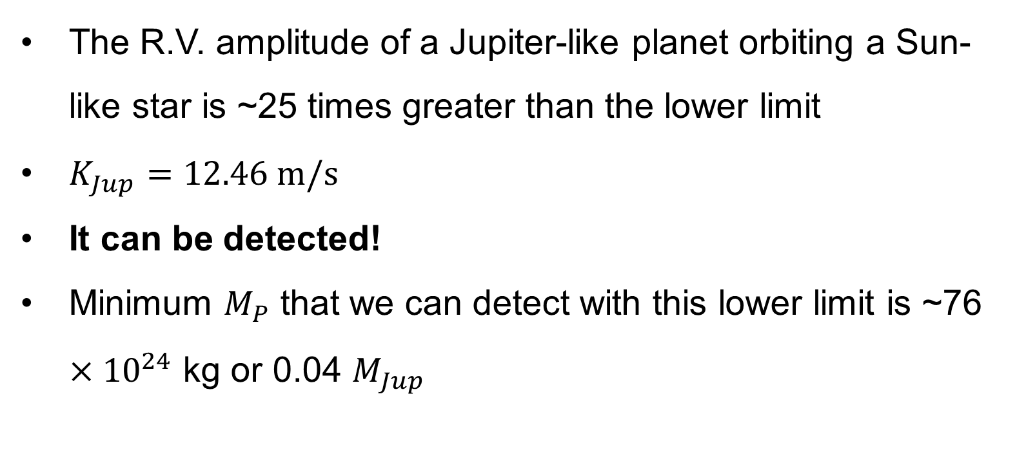
Results – Radial Velocity
The R.V. amplitude of a Jupiter-like planet orbiting a Sun-like star is ~25 times greater than the lower limit
$K_{Jup}=12.46 m/s$
It can be detected!
Minimum $M_{P}$ that we can detect with this lower limit is ~76 $×{10}^{24}$ kg or 0.04 $M_{Jup}$

Slide 12
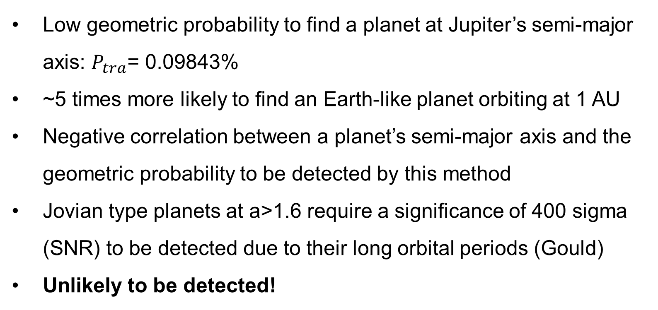
Results – Transit photometry
Low geometric probability to find a planet at Jupiter’s semi-major axis: $P_{tra}$= 0.09843%
~5 times more likely to find an Earth-like planet orbiting at 1 AU
Negative correlation between a planet’s semi-major axis and the geometric probability to be detected by this method
Jovian type planets at a>1.6 require a significance of 400 sigma (SNR) to be detected due to their long orbital periods (Gould)
Unlikely to be detected!

Slide 13
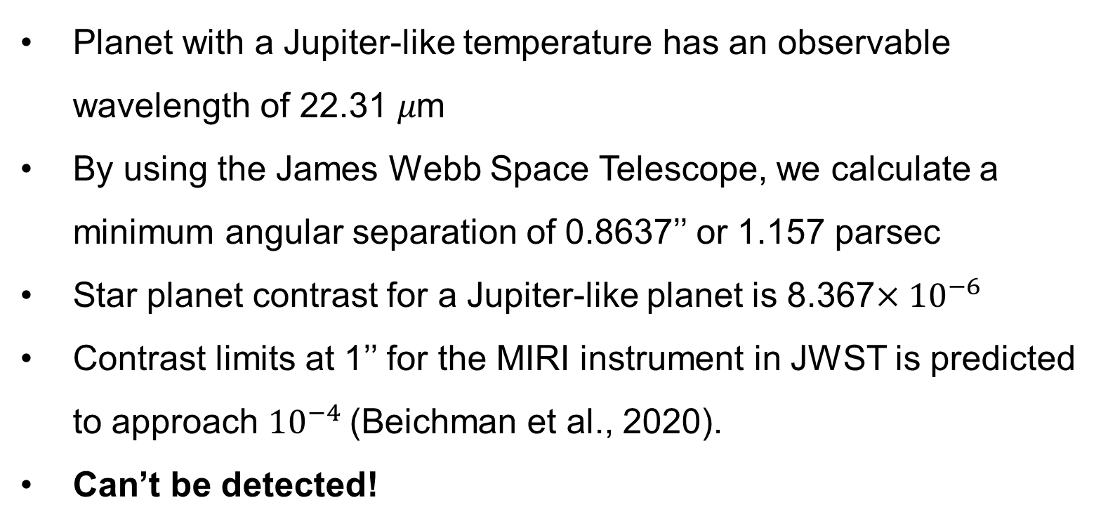
Results – Direct Imaging
Planet with a Jupiter-like temperature has an observable wavelength of 22.31 𝜇m
By using the James Webb Space Telescope, we calculate a minimum angular separation of 0.8637’’ or 1.157 parsec
Star planet contrast for a Jupiter-like planet is 8.367$×{10}^{−6}$
Contrast limits at 1’’ for the MIRI instrument in JWST is predicted to approach ${10}^{−4}$(Beichman et al., 2020).
Can’t be detected!

Slide 14
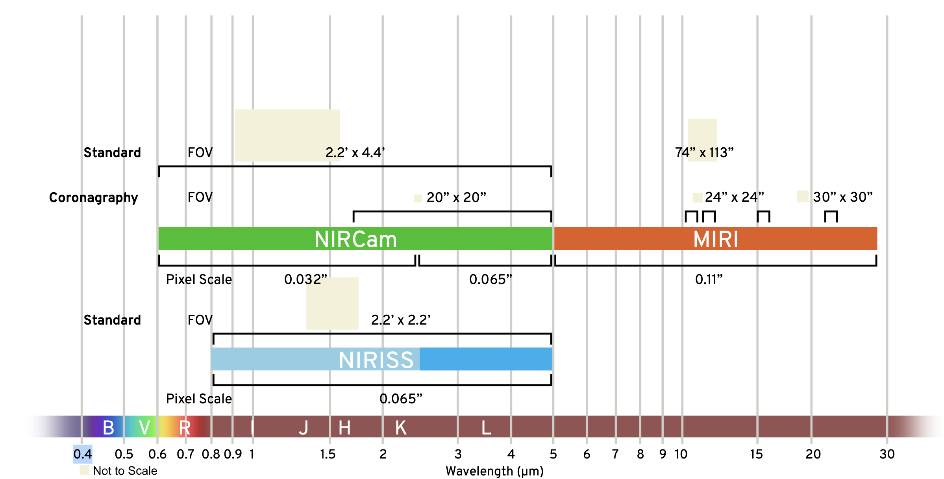
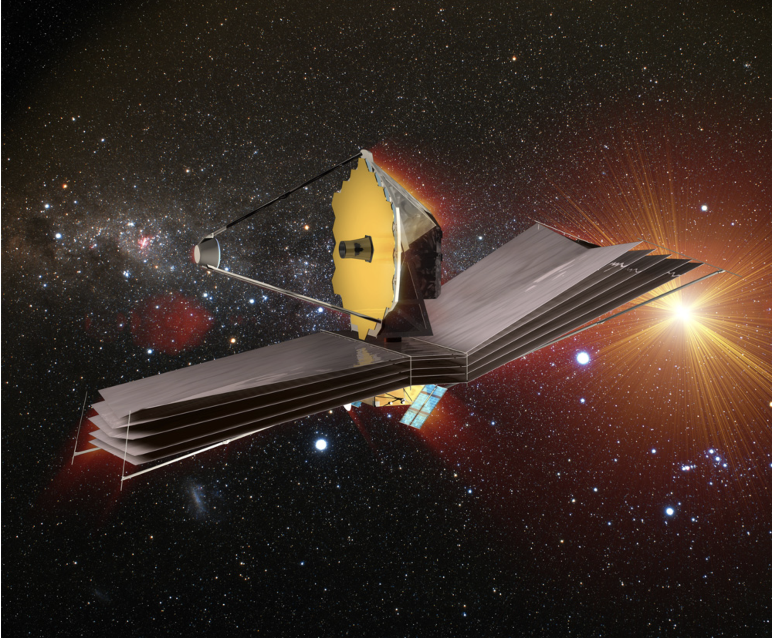
James Webb Space Telescope – MIRI Instrument
Operates between 5-28 𝜇m
Launch Date: December 25, 2021

Slide 15

Conclusions
Can we find a Jupiter-like planet using:
Radial velocity method? Yes (large planetary mass → measurable wobble)
Transit photometry? Unlikely (0.01% chance)
Direct imaging? No (not enough black body emission)
Different methods serve different purposes

Slide 16
Contributions
Ashley – Written report
Alex – Research of the art technology
Yuanhao and Missie – Coding and making plots
Mariana – Presentation
Questions?

Slide 17
References
Beichman, C., Barrado, D., Belikov, R., Biller, B., Boccaletti, A., Burrows, A., ... & Ygouf, M. (2019). Direct imaging and spectroscopy of exoplanets with the James Webb Space Telescope. Bulletin of the American Astronomical Society, 51(3), 58.
Williams, D. (2016). Planetary fact sheets. NASA. Retrieved February 2, 2022, from https://nssdc.gsfc.nasa.gov/planetary/planetfact.html
NASA. (n.d.). Key facts - webb/NASA. NASA. Retrieved February 2, 2022, from https://webb.nasa.gov/content/about/faqs/facts.html
Image source: The Planetary Society

